Slide 1

CSC 177- Data Analytics and Mining
Project 4: Cluster Analysis, ANN and Text Mining Project
## Team Challengers (23):
1. Srujay Reddy Vangoor
2. Vaibhav Jain
3. Bashar Allwza
4. Varun Bailapudi
5. Uddayankith Chodagam

Slide 2
Cluster Analysis

Slide 3
Cluster Analysis
Cluster analysis or clustering is the task of grouping a set of objects in such a way that objects in the same group (called a cluster) are more similar (in some sense) to each other than to those in other groups (clusters).
Clustering is an unsupervised learning technique, meaning that it does not rely on labeled data or a pre-existing classification scheme. Instead, clustering algorithms identify patterns in the data based on similarities or differences between data points and group them together into clusters based on those similarities or differences.

Slide 4
Cluster Analysis (Contd.)
Cluster analysis itself is not one specific algorithm, but the general task to be solved. It can be achieved by various algorithms that differ significantly in their understanding of what constitutes a cluster and how to efficiently find them.

Slide 5
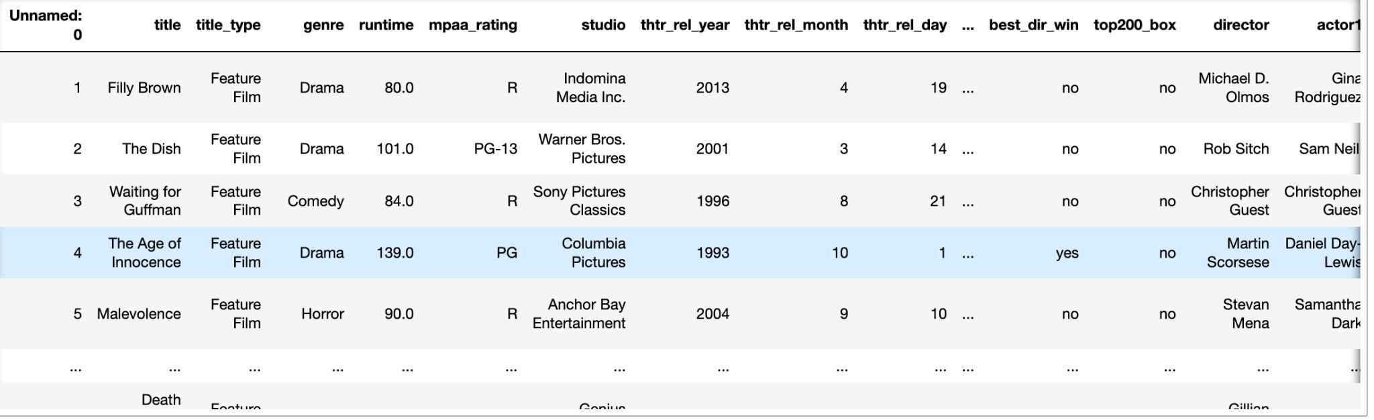
About the Dataset
IMDB movie review dataset is used to demonstrate the clustering algorithms.

Slide 6
K-Means Clustering
K-means clustering is a popular unsupervised machine learning algorithm used to group data points into clusters based on similarity.
It is a centroid-based clustering algorithm that iteratively partitions the data points into k clusters, where k is a pre-specified number of clusters. The algorithm starts by randomly selecting k initial centroids, and then it iteratively assigns each data point to the nearest centroid, computes the mean of each cluster, and reassigns the centroids based on the new means. This process continues until the centroids no longer move significantly or until a predetermined number of iterations is reached.

Slide 7
K-Means Clustering (Contd.)
K-means clustering is widely used for image segmentation, market segmentation, anomaly detection, and many other applications. One of the main advantages of k-means clustering is that it is computationally efficient and can handle large datasets. However, one of the limitations of k-means clustering is that it requires the number of clusters to be specified beforehand, and the quality of the results is highly dependent on the initial placement of the centroids.

Slide 8
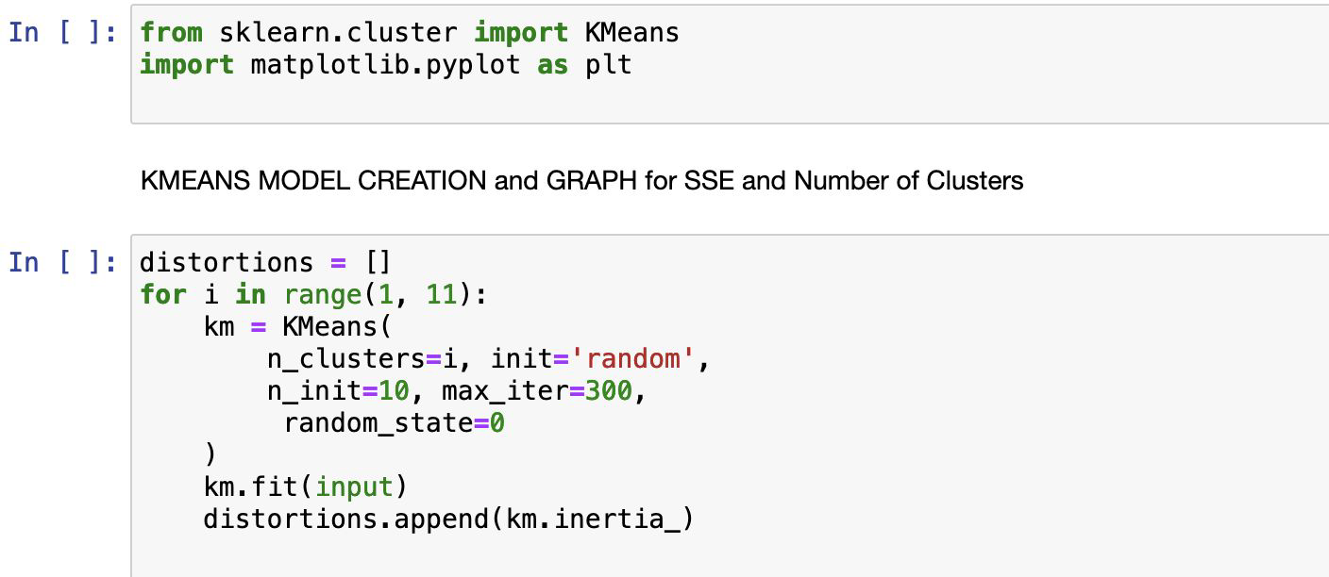
K-Means Clustering (Contd.)

Slide 9
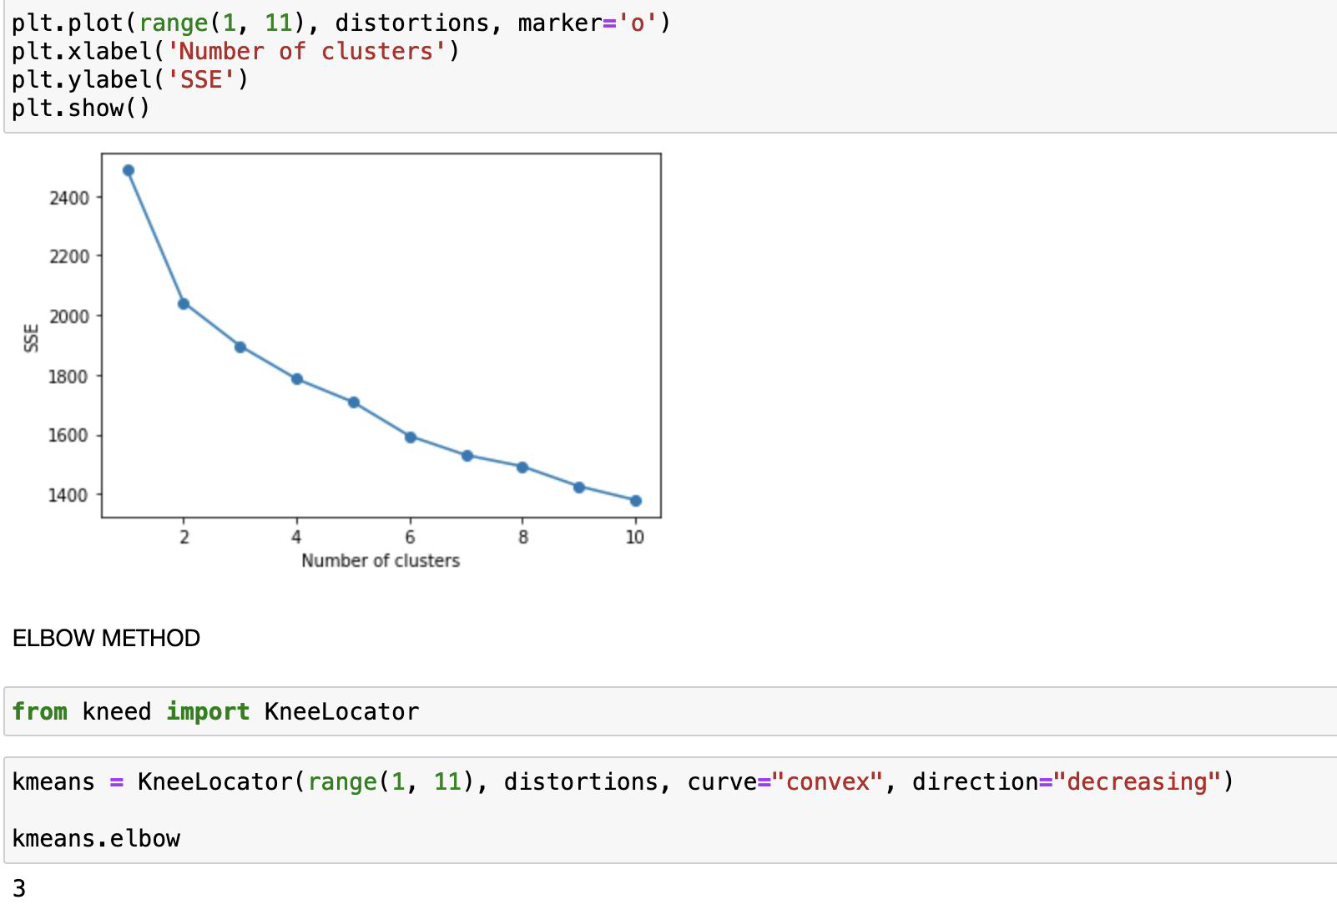
K-Means Clustering (Contd.)

Slide 10
Hierarchical Clustering
Hierarchical clustering is a type of clustering algorithm used in data mining and machine learning. It is a method for grouping similar data points or objects into clusters based on their similarity or dissimilarity. In hierarchical clustering, the data points are recursively partitioned into a hierarchy of clusters.
There are two main types of hierarchical clustering: Agglomerative hierarchical clustering and Divisive hierarchical clustering.

Slide 11
Hierarchical Clustering (Contd.)
Agglomerative hierarchical clustering: This method starts with each data point as a separate cluster and then merges the closest pairs of clusters iteratively until only one cluster remains.
Divisive hierarchical clustering: This method starts with all data points in one cluster and then recursively divides it into smaller subclusters based on their dissimilarity.

Slide 12
Hierarchical Clustering (Contd.)
Hierarchical clustering can be visualized using dendrograms, which are tree-like diagrams that show the order and distances of the merging or splitting of clusters. The height of the dendrogram indicates the distance between clusters or the dissimilarity between data points.

Slide 13
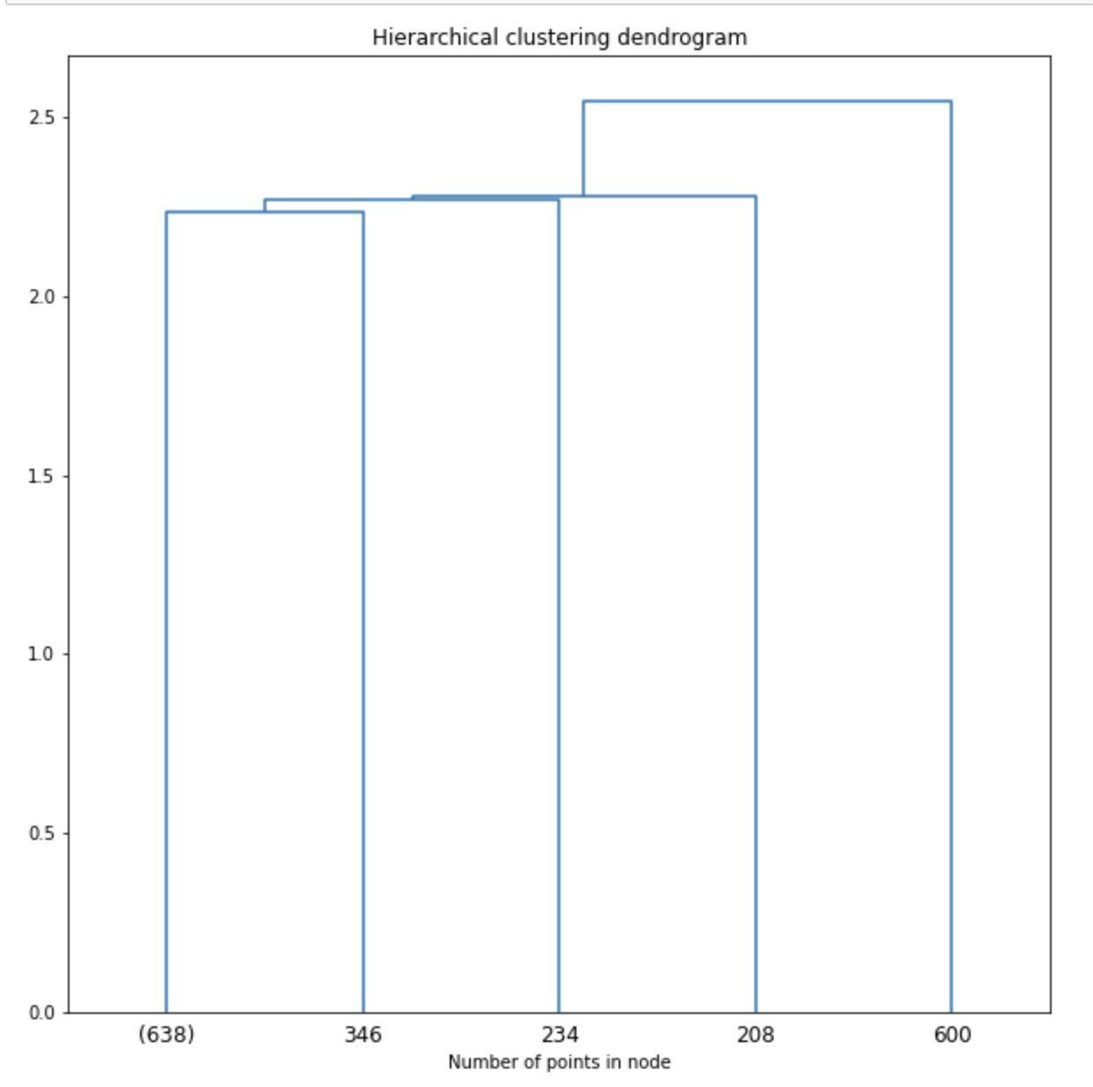
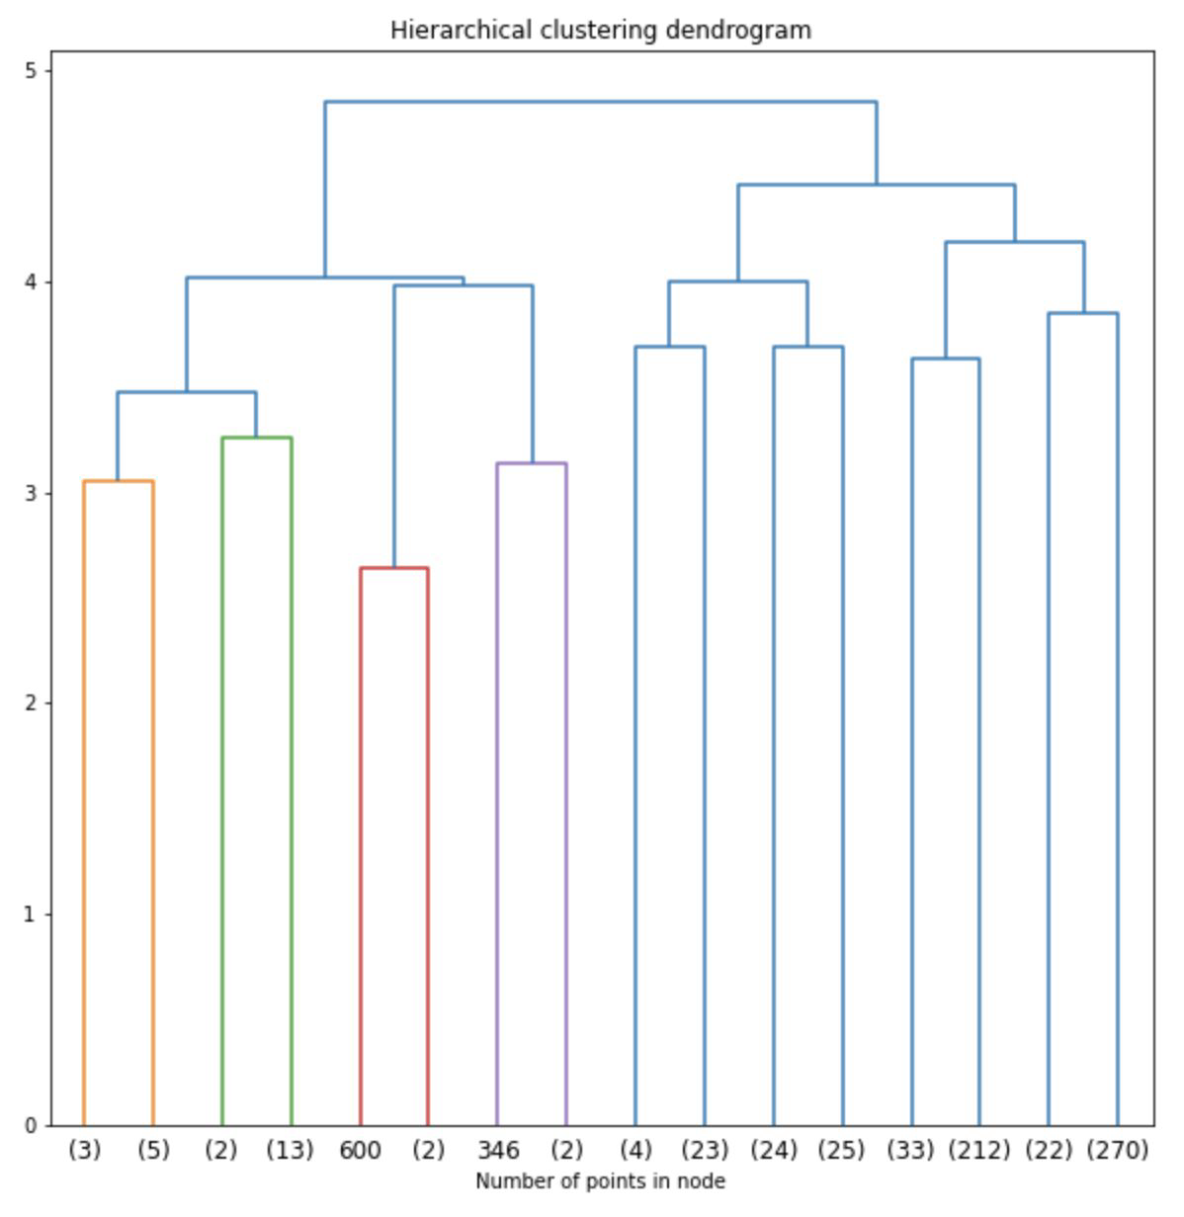
Hierarchical Clustering (Contd.)

Slide 14
Artificial Neural Networks (ANNs)

Slide 15
Artificial Neural Networks (ANNs)
Artificial neural networks (ANNs) are computational models inspired by the structure and function of the human brain. They are composed of interconnected nodes that process information, called artificial neurons or simply "neurons." These neurons are organized into layers, with each layer performing a different computation on the input data.

Slide 16
Artificial Neural Networks (Contd.)
ANNs are typically used for supervised learning tasks, such as classification or regression. During training, the network is presented with a set of labeled examples and adjusts its weights to minimize the difference between its predicted output and the actual output.
Once the network is trained, it can be used to make predictions on new, unseen data. ANNs have been successfully applied in a wide range of fields, including computer vision, natural language processing, speech recognition, and robotics.

Slide 17
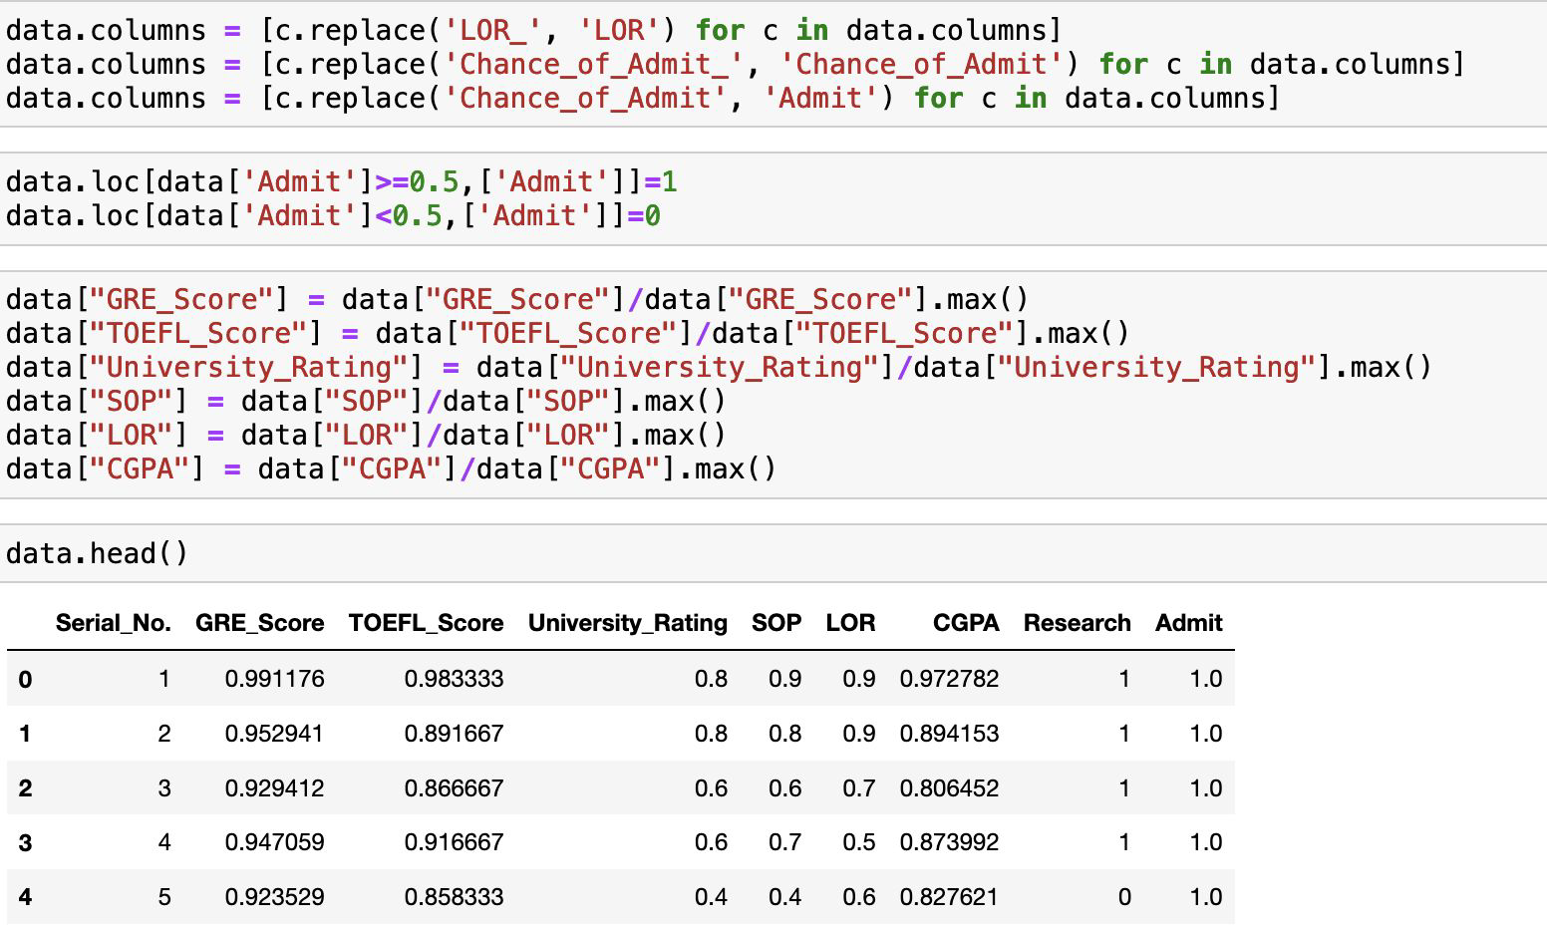
Artificial Neural Networks (Contd.)

Slide 18
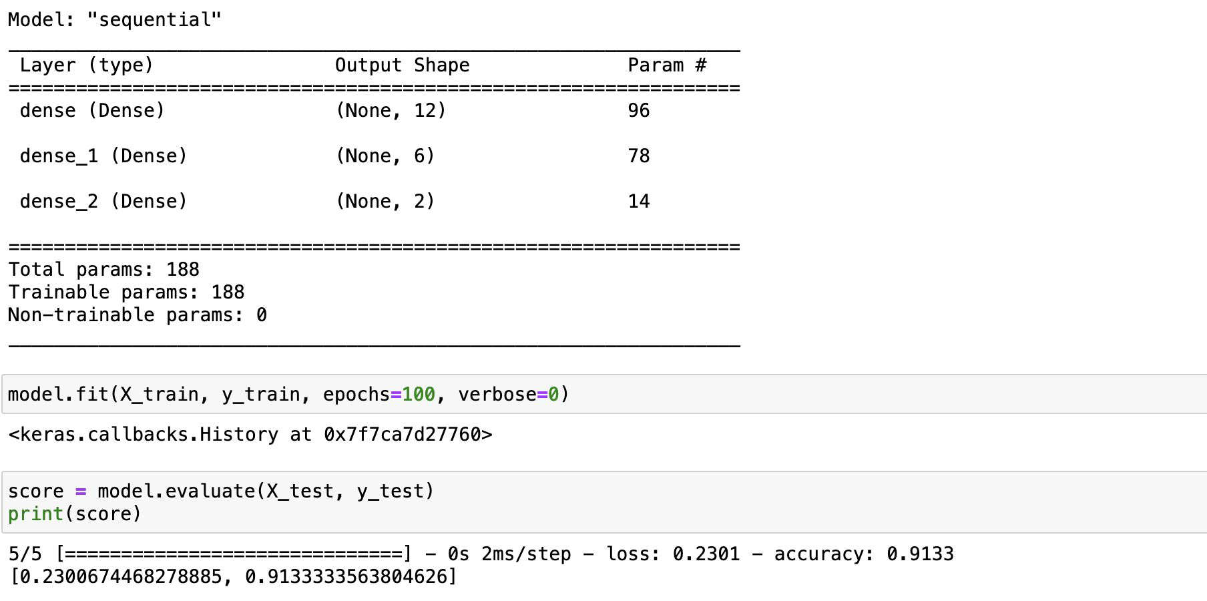
Artificial Neural Networks (Contd.)

Slide 19
Text Mining

Slide 20
Text Mining
Text mining, also known as text data mining, is the process of deriving meaningful insights and information from unstructured textual data. Text mining involves the application of natural language processing (NLP), information retrieval, and machine learning techniques to extract and analyze information from unstructured text data.

Slide 21
Text Mining (Contd.)
Text mining is used to identify patterns, relationships, and insights from large collections of textual data, such as emails, social media posts, customer reviews, news articles, and scientific literature. Text mining techniques can be applied to a variety of tasks, including sentiment analysis, topic modeling, named entity recognition, and text classification.
Text mining is an important technique in data mining because it enables organizations to extract valuable insights and knowledge from unstructured textual data, which can be used to inform business decisions, improve customer satisfaction, and gain a competitive advantage.

Slide 22
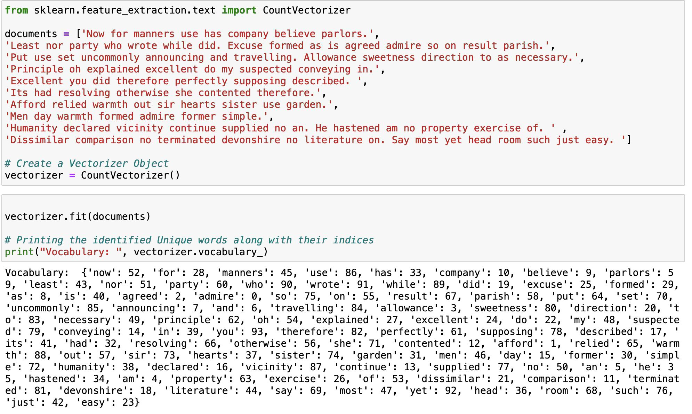
Text Mining (Contd.)

Slide 23
TF-IDF Vectors
TF-IDF stands for "Term Frequency-Inverse Document Frequency". In text mining and information retrieval, it is a numerical statistic that reflects how important a word is to a document in a collection or corpus.
The term frequency is the number of occurrences of a specific term in a document. Term frequency indicates how important a specific term in a document.
Document frequency is the number of documents containing a specific term. Document frequency indicates how common the term is.

Slide 24
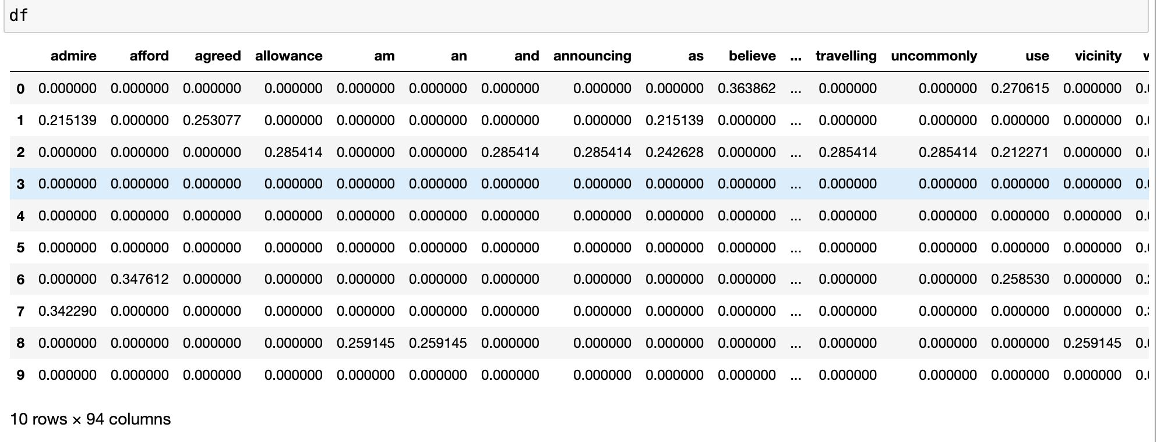
TF-IDF Vectors (Contd.)

Slide 25
Thank you!!

